Slide 1
Dynamics of Neuronal Firing Correlation: Modulation of “Effective Connectivity”
Abdul Ghani Khan

Slide 2
Introduction
Neurons in a multi-neuron recording, a most useful tool has been the cross-correlation of the two spike trains (29; for reviews, see Refs. 12 and 20). This calculation measures the probability of firing of the “target” neuron at various times relative to the firing of the “reference” neuron, in which the probability is determined by averaging over many occurrences of the two spikes.

Slide 3
Any man could, if he were so inclined, be the sculptor of his own brain.”. “A neuron didn’t know whether it fired in response to a scent or a symphony. Brain cells weren’t intelligent; only brains were.”. “Neurons giveth and neurons taketh away.”.
“
”
A Wise Man

Slide 4
It is appropriate for the intercomparison of different pieces of data with the null hypothesis However, we now need a measure of significance to interpret the deviations from the null hypothesis. The usual approach to significance testing consists of comparing the actual outcome of an experiment with the postulated distribution of values under the null hypothesis. In our case, we need to identify this postulated distribution for the JPSTH value in a given bin. The point o
Significance

Slide 5
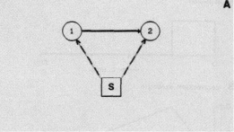
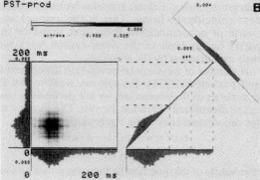
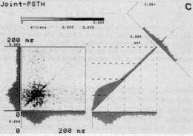
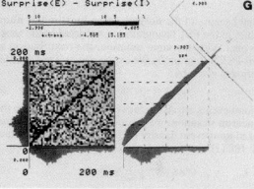
Many of the concepts and measurements used with spike trains have been developed and calibrated with the use of pulse trains from simulated neuronal circuits. In that case, the measurements for a given circuit can be predicted: this is the “forward problem.” We are fully aware that there is no unique solution to the “inverse problem,” i.e., it is impossible to determine uniquely the underlying circuit by spike-train analysis (or any other method that avoids exhaustive
Some Concepts

Slide 6
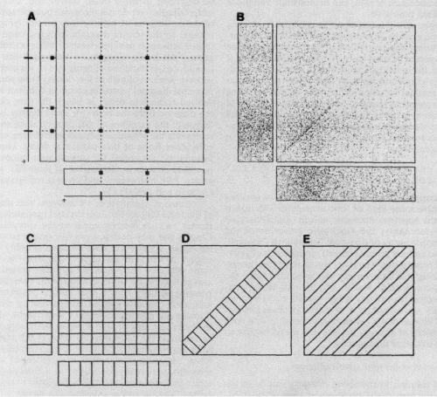
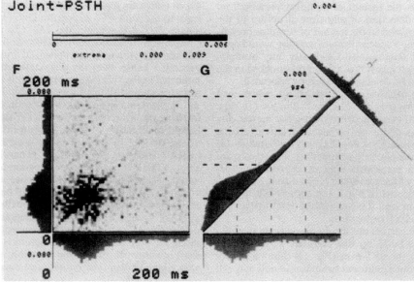
The Joint Peristimulus Time Scatter Diagram.

Slide 7
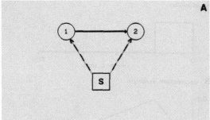
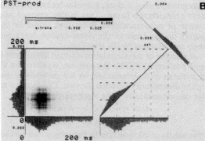
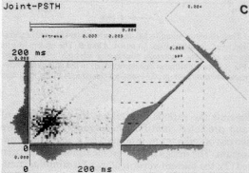
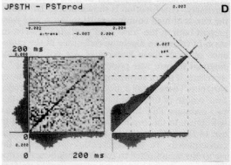
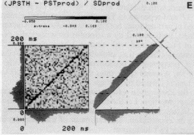
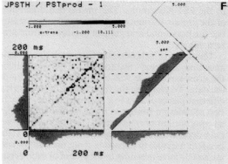

COMPARISON OF RAW PREDICTED JOINT PST HISTOGRAMS

Slide 8
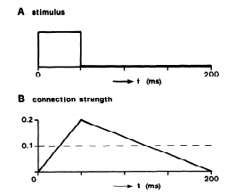
Graphical Representation Of Stimulus

Slide 9
About The Work
This work was started independently in several laboratories and brought together during 1986-87 during a Sabbatical stay by G.‘L. Gerstein at the Max-Planck-Institute for Biological Cybernetics. We are grateful to Prof. Valentino Braitenberg for this opportunity. T. Bonhoeffer was involved in early phases of this project. We thank V. Staiger for his skillful photography of endless series of display screens and V. Braitenberg, A. Kreiter, and A. Schtiz for critical reading of the manuscript.

Slide 10
Summary
We reexamined the possibilities for analyzing and interpretng the time course of correlation in spike trains simultaneously and separably recorded from two neurons.” and “contribution”) to include possible stimuluslocked time variations. 6. Application of the new procedures to real spike trains from several different preparations showed that fast‘ stimulus-locked modulations of “effective connectivity

Slide 11
Thank you
Abdul Ghani Khan
22P-9037
aghani0348@gmail.com
03489656043

